Slide 1
Data Mining
Classification: Alternative Techniques
© Tan,Steinbach, Kumar Introduction to Data Mining 4/18/2004 <number>

Slide 2
Rule-Based Classifier
Classify records by using a collection of “if…then…” rules
Rule: (Condition) → y
  where y is the class label
  LHS: rule antecedent or condition
  RHS: rule consequent
  Examples of classification rules:
    (Blood Type=Warm) ∧ (Lay Eggs=Yes) → Birds

Slide 3
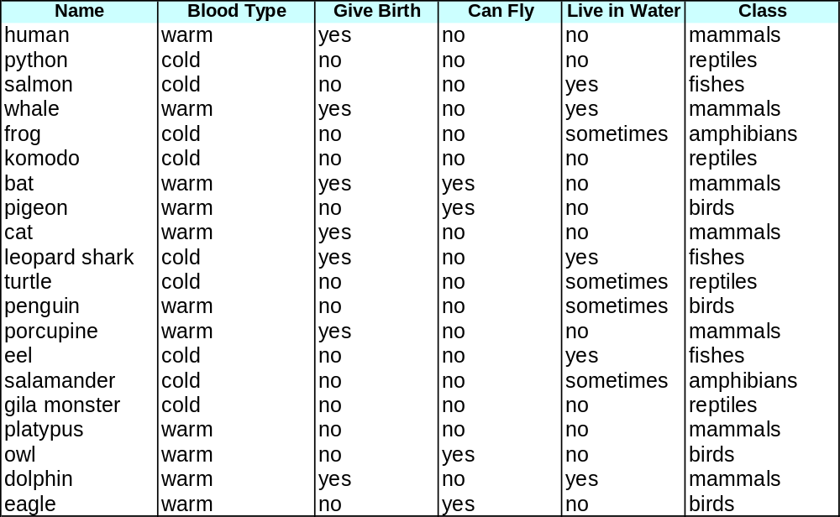
Rule-based Classifier (Example)
R1: (Give Birth = no) ∧ (Can Fly = yes) → Birds
R2: (Give Birth = no) ∧ (Live in Water = yes) → Fishes
R3: (Give Birth = yes) ∧ (Blood Type = warm) → Mammals
R4: (Give Birth = no) ∧ (Can Fly = no) → Reptiles
R5: (Live in Water = sometimes) → Amphibians

Slide 4
Application of Rule-Based Classifier
A rule r covers an instance x if the attributes of the instance satisfy the condition of the rule
R1: (Give Birth = no) ∧ (Can Fly = yes) → Birds
R2: (Give Birth = no) ∧ (Live in Water = yes) → Fishes
R3: (Give Birth = yes) ∧ (Blood Type = warm) → Mammals
R4: (Give Birth = no) ∧ (Can Fly = no) → Reptiles
R5: (Live in Water = sometimes) → Amphibians
The rule R1 covers a hawk => hawk is Bird
The rule R3 covers a bear => bear is Mammal

Slide 5
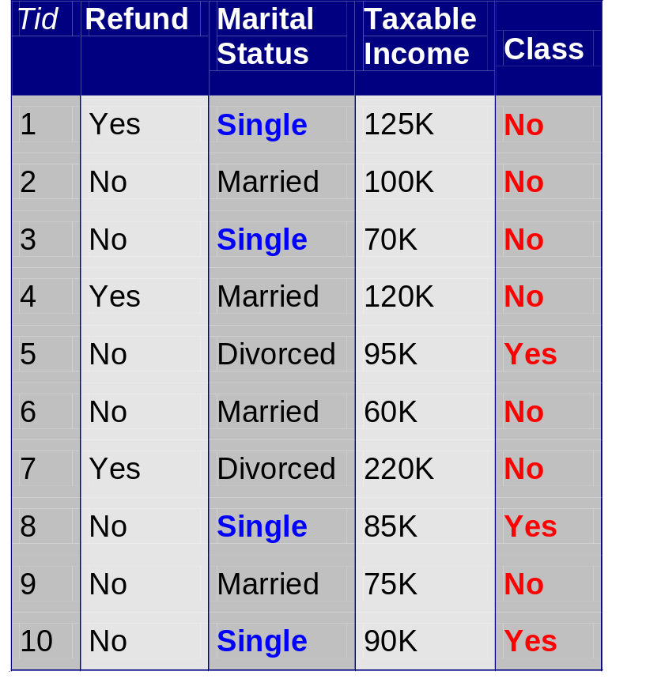
Rule Coverage and Accuracy
Coverage of a rule:
  Fraction of records that satisfy the antecedent of a rule
Accuracy of a rule:
  Fraction of records that satisfy both the antecedent and consequent of a rule
(Status=Single) → No
Coverage = 40%, Accuracy = 50%

Slide 6
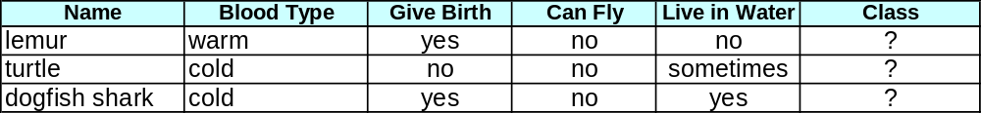
How does Rule-based Classifier Work?
R1: (Give Birth = no) ∧ (Can Fly = yes) → Birds
R2: (Give Birth = no) ∧ (Live in Water = yes) → Fishes
R3: (Give Birth = yes) ∧ (Blood Type = warm) → Mammals
R4: (Give Birth = no) ∧ (Can Fly = no) → Reptiles
R5: (Live in Water = sometimes) → Amphibians
A lemur triggers rule R3, so it is classified as a mammal
A turtle triggers both R4 and R5
A dogfish shark triggers none of the rules

Slide 7
Characteristics of Rule-Based Classifier
Mutually exclusive rules
  Classifier contains mutually exclusive rules if the rules are independent of each other
  Every record is covered by at most one rule
Exhaustive rules
  Classifier has exhaustive coverage if it accounts for every possible combination of attribute values
  Each record is covered by at least one rule

Slide 8
Effect of Rule Simplification
Rules are no longer mutually exclusive
  A record may trigger more than one rule
  Solution?
    Ordered rule set
    Unordered rule set – use voting schemes
Rules are no longer exhaustive
  A record may not trigger any rules
  Solution?
    Use a default class

Slide 9
Ordered Rule Set
Rules are rank ordered according to their priority
  An ordered rule set is known as a decision list
When a test record is presented to the classifier
  It is assigned to the class label of the highest ranked rule it has triggered
  If none of the rules fired, it is assigned to the default class
R1: (Give Birth = no) ∧ (Can Fly = yes) → Birds
R2: (Give Birth = no) ∧ (Live in Water = yes) → Fishes
R3: (Give Birth = yes) ∧ (Blood Type = warm) → Mammals
R4: (Give Birth = no) ∧ (Can Fly = no) → Reptiles
R5: (Live in Water = sometimes) → Amphibians

Slide 10
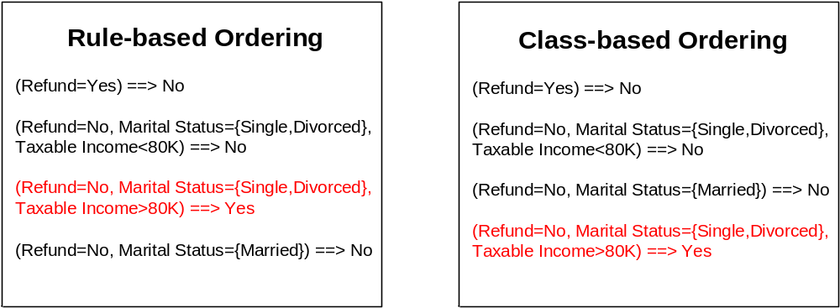
Rule Ordering Schemes
Rule-based ordering
  Individual rules are ranked based on their quality
Class-based ordering
  Rules that belong to the same class appear together

Slide 11
Building Classification Rules
Direct Method:
    Extract rules directly from data
    e.g. RIPPER
Indirect Method:
    Extract rules from other classification models (e.g.
    decision trees, neural networks, etc.)
    e.g. C4.5rules

Slide 12
Direct Method: Sequential Covering
Start from an empty rule
Grow a rule using the Learn-One-Rule function
Remove training records covered by the rule
Repeat Step (2) and (3) until stopping criterion is met

Slide 13
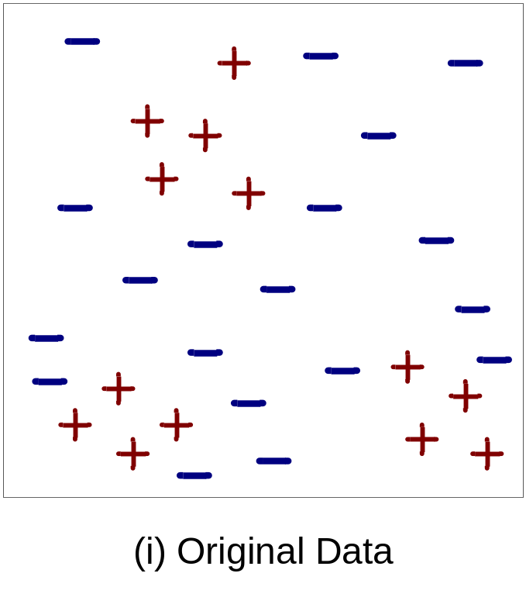
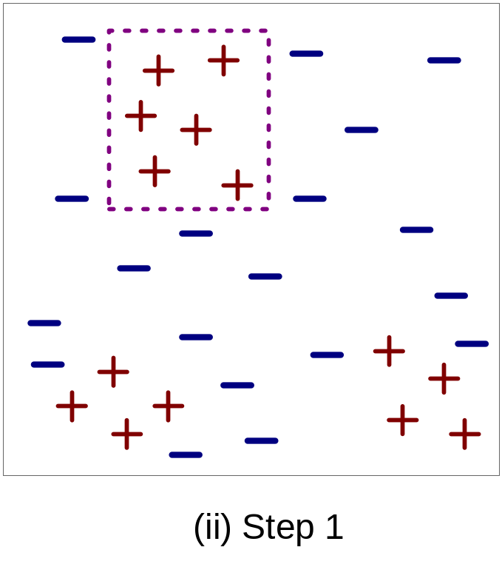
Example of Sequential Covering

Slide 14
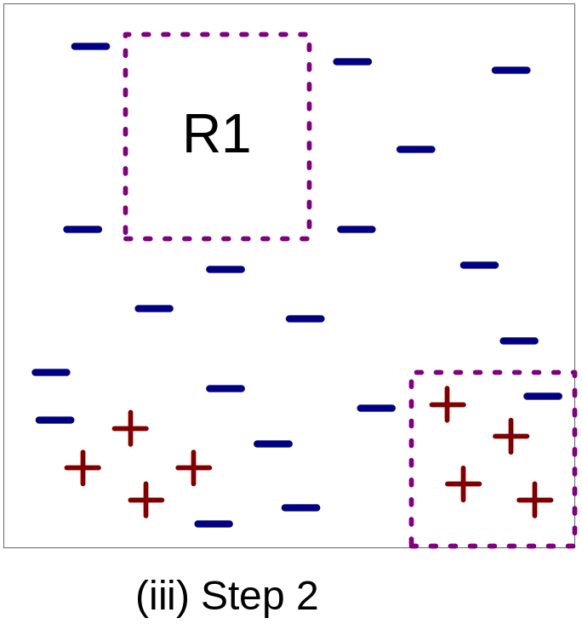
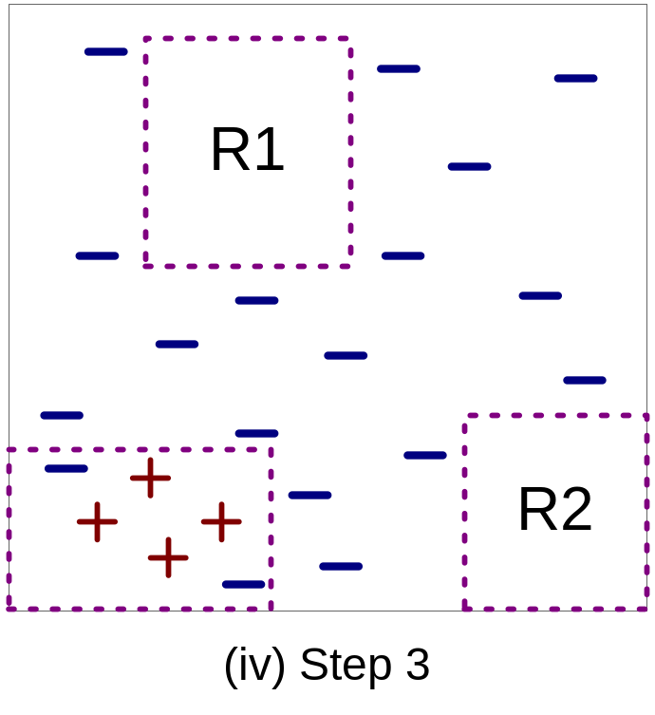
Example of Sequential Covering…

Slide 15
Aspects of Sequential Covering
Rule Growing
Instance Elimination
Rule Evaluation
Stopping Criterion
Rule Pruning

Slide 16
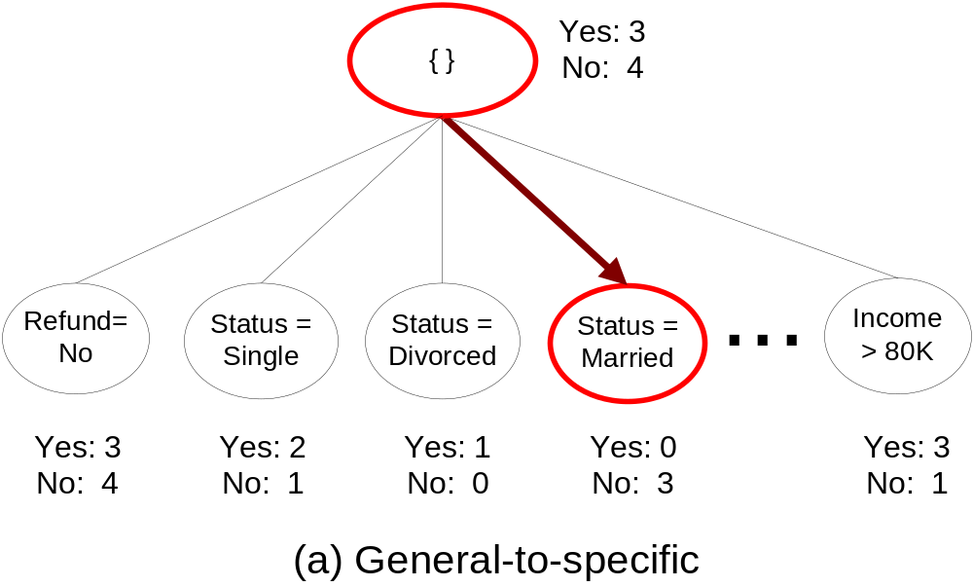
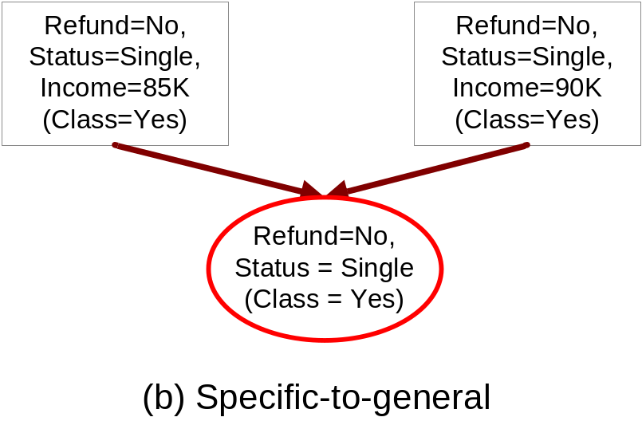
Rule Growing
Two common strategies

Slide 17
Rule Growing (Examples)
RIPPER Algorithm:
  Start from an empty rule: {} => class
  Add conjuncts that maximizes FOIL’s information gain measure:
    R0: {} => class (initial rule)
    R1: {A} => class (rule after adding conjunct)
    Gain(R0, R1) = p1 [ log (p1/(p1+n1)) – log (p0/(p0 + n0)) ]
    where p0: number of positive instances covered by R0
    n0: number of negative instances covered by R0
    p1: number of positive instances covered by R1
    n1: number of negative instances covered by R1

Slide 18
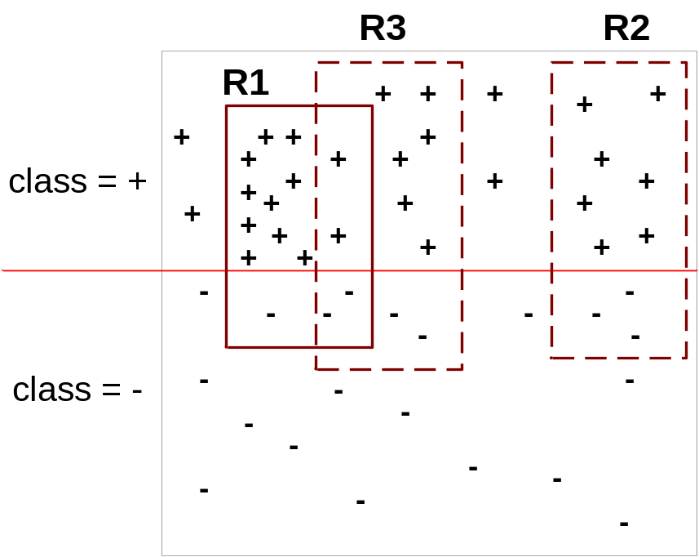
Instance Elimination
Why do we need to eliminate instances?
  Otherwise, the next rule is identical to previous rule
  Remove positive instances to ensure that the next rule is different
  Remove negative instances to prevent underestimating accuracy of rule

Slide 19
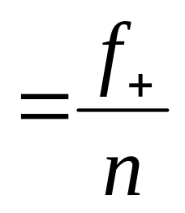
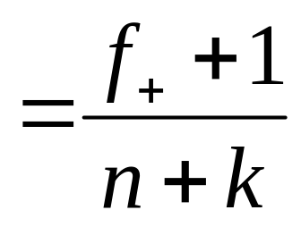
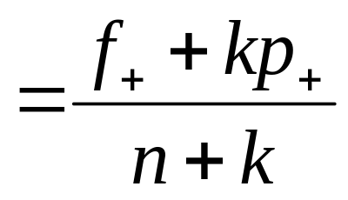
Rule Evaluation
Metrics:
  Accuracy
  Laplace
  M-estimate
n : Number of instances covered by rule
f₊ : Number of positive instances covered by rule
k : Number of classes
p₊ : Prior probability for positive class

Slide 20
Rule Evaluation Example
Consider a training set that contains 60 positive examples and 100 negative examples.
  Rule r1 covers 50 positive examples and 5 negative examples
  Rule r2 covers 2 positive examples and no negative examples
  Accuracy of r1=50/55=90.9%, accuracy of r2=2/2=100%
  Laplace measure for r1=(50+1)/(55+2)=89.47%, Laplace measure for r2=(2+1)/(2+2)=75%

Slide 21
Stopping Criterion and Rule Pruning
Stopping criterion
  Compute the gain
  If gain is not significant, discard the new rule
Rule Pruning
  Similar to post-pruning of decision trees
  Reduced Error Pruning:
    Remove one of the conjuncts in the rule
    Compare error rate on validation set before and after pruning
    If error improves, prune the conjunct

Slide 22
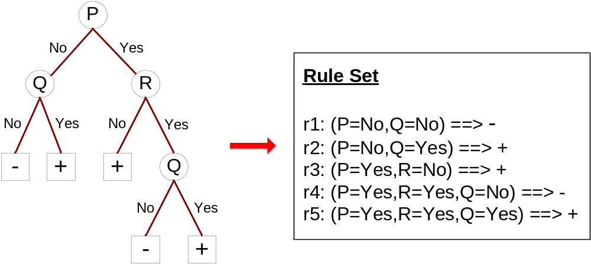
Indirect Methods

Slide 23
Indirect Method: C4.5rules
Extract rules from an unpruned decision tree
For each rule, r: A → y,
  consider an alternative rule r’: A’ → y where A’ is obtained by removing one of the conjuncts in A
  Compare the pessimistic error rate for r against all r’s
  Prune if one of the r’s has lower pessimistic error rate
  Repeat until we can no longer improve generalization error

Slide 24
Indirect Method: C4.5rules
Instead of ordering the rules, order subsets of rules (class ordering)
  Each subset is a collection of rules with the same rule consequent (class)
  Compute description length of each subset
    Description length = L(error) + g L(model)
    g is a parameter that takes into account the presence of redundant attributes in a rule set
    (default value = 0.5)

Slide 25
Advantages of Rule-Based Classifiers
As highly expressive as decision trees
Easy to interpret
Easy to generate
Can classify new instances rapidly
Performance comparable to decision trees

Slide 26
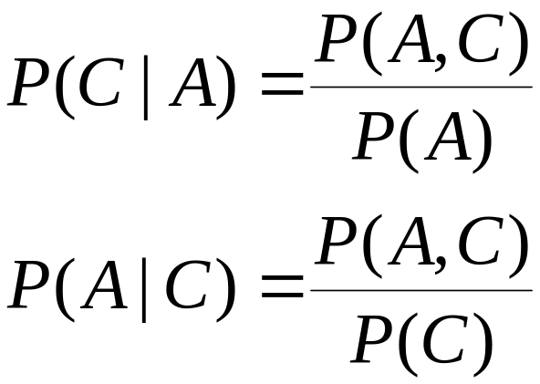
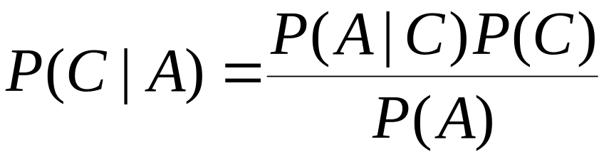
Bayes Classifier
A probabilistic framework for solving classification problems
Conditional Probability:
Bayes theorem:

Slide 27
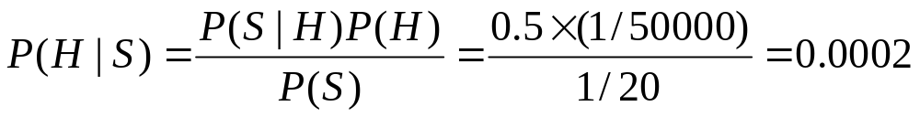
Example of Bayes Theorem
Imagine a population of 100K…
Imagine a population of 100K... About 2 have heart disease (1 of them has stiff neck). 5K just have stiff neck w/o heart disease. So if someone has stiff neck, the chance he has heart disease is about 1 out of 5K, i.e., 0.0002.
Given:
  A doctor knows that heart disease causes stiff neck 50% of the time
  Prior probability of any patient having heart disease is 1/50,000
  Prior probability of any patient having stiff neck is 1/20
If a patient has stiff neck, what’s the probability he/she has heart disease?

Slide 28
Bayesian Classifiers
Consider each attribute and class label as random variables
Given a record with attributes (A₁, A₂,…,A_{n})
  Goal is to predict class C
  Specifically, we want to find the value of C that maximizes P(C| A₁, A₂,…,A_{n} )

Slide 29
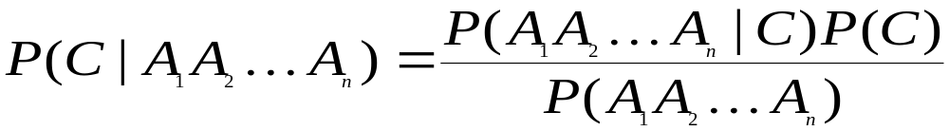
Bayesian Classifiers
Approach:
  compute the posterior probability P(C | A₁, A₂, …, A_{n}) for all values of C using the Bayes theorem
  Choose value of C that maximizes
  P(C | A₁, A₂, …, A_{n})
  Equivalent to choosing value of C that maximizes
  P(A₁, A₂, …, A_{n}|C) P(C)

Slide 30
Naïve Bayes Classifier
Assume independence among attributes A_{i} when class is given:
  P(A₁, A₂, …, A_{n} | C_{j}) = P(A₁| C_{j}) P(A₂| C_{j})… P(A_{n}| C_{j})
  Can estimate P(A_{i}| C_{j}) for all A_{i} and C_{j} from training data
  New data point is classified to C_{j} if P(C_{j}) Π P(A_{i}| C_{j}) is maximal

Slide 31
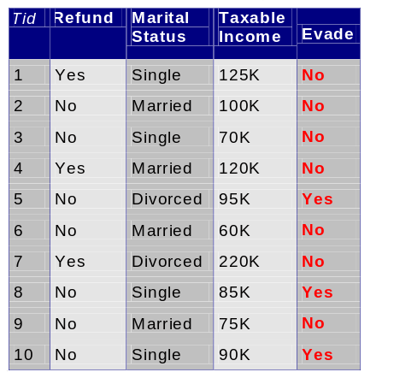
How to Estimate Probabilities from Data?
Class: P(C) = N_{c}/N
  e.g., P(No) = 7/10,
  P(Yes) = 3/10
For discrete attributes:
P(A_{i} | C_{k}) = |A_{ik}|/ N_{c}
  where |A_{ik}| is number of instances having attribute A_{i} and belongs to class C_{k}
  Examples:
  P(Status=Married|No) = 4/7
  P(HomeOwner=Yes|Yes)=0
Home
Owner
Defaulted
Borrower
k

Slide 32
How to Estimate Probabilities from Data?
For continuous attributes:
  Discretize the range into bins
    one ordinal attribute per bin
    violates independence assumption
  Two-way split: (A < v) or (A > v)
    choose only one of the two splits as new attribute
  Probability density estimation:
    Assume attribute follows a normal distribution
    Use data to estimate parameters of distribution
    (e.g., mean and standard deviation)
    Once probability distribution is known, can use it to estimate the conditional probability P(A_{i}|C)

Slide 33
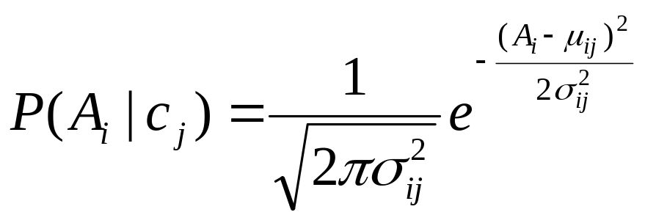
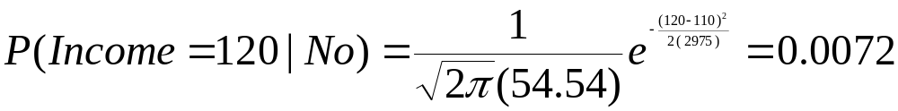
How to Estimate Probabilities from Data?
Normal distribution:
  One for each (A_{i},c_{i}) pair
  e.g. for (Income, Class=No)
    sample mean µ = 110
    sample variance σ² = 2975

Slide 34
Example of Naïve Bayes Classifier
Given a Test Record:
P(X|Class=No) = P(HomeOwner=No|Class=No)
× P(Married| Class=No)
× P(Income=120K| Class=No)
= 4/7 × 4/7 × 0.0072 = 0.0024
P(X|Class=Yes) = P(HomeOwner=No| Class=Yes)
× P(Married| Class=Yes)
× P(Income=120K| Class=Yes)
= 1 × 0 × 1.2 × 10⁻⁹ = 0
Since P(X|No)P(No) > P(X|Yes)P(Yes)
Therefore P(No|X) > P(Yes|X)
=> Class = No

Slide 35
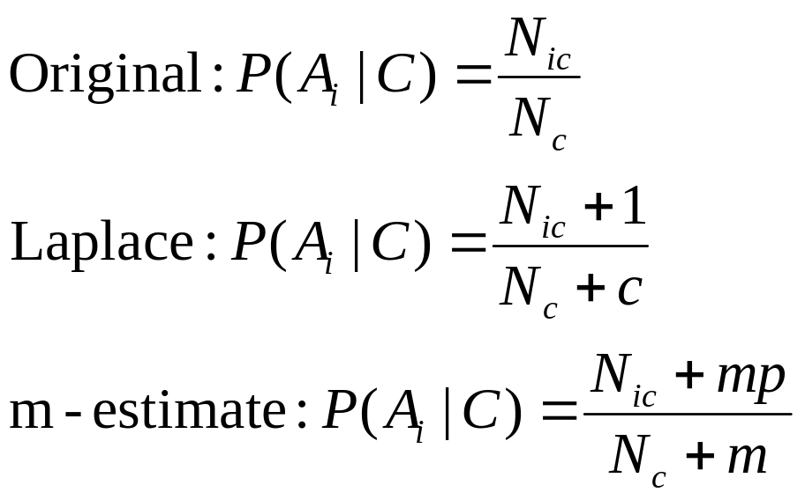
Naïve Bayes Classifier
If one of the conditional probability is zero, then the entire expression becomes zero
Probability estimation:
c: number of classes
p: prior probability
m: parameter

Slide 36
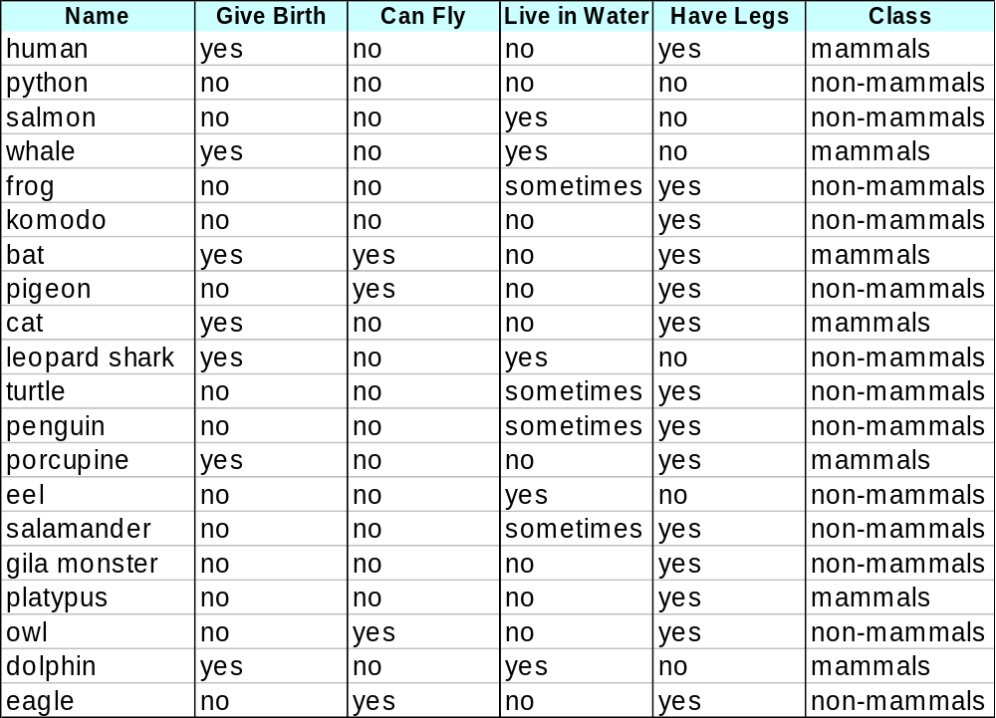
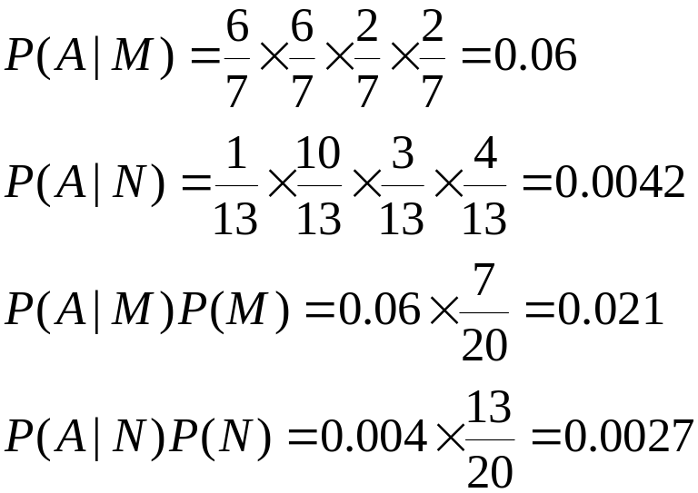
Example of Naïve Bayes Classifier
A: attributes
M: mammals
N: non-mammals
P(A|M)P(M) > P(A|N)P(N)
=> Mammals

Slide 37
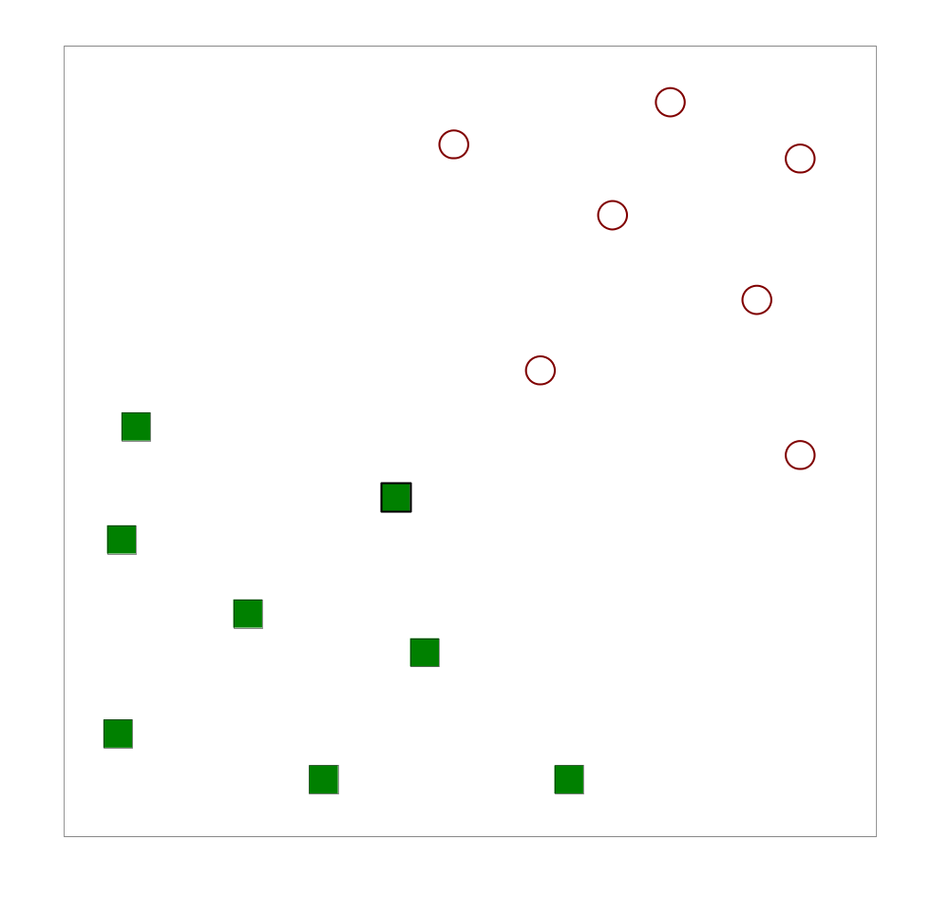
Support Vector Machines
Find a linear hyperplane (decision boundary) that will separate the data

Slide 38
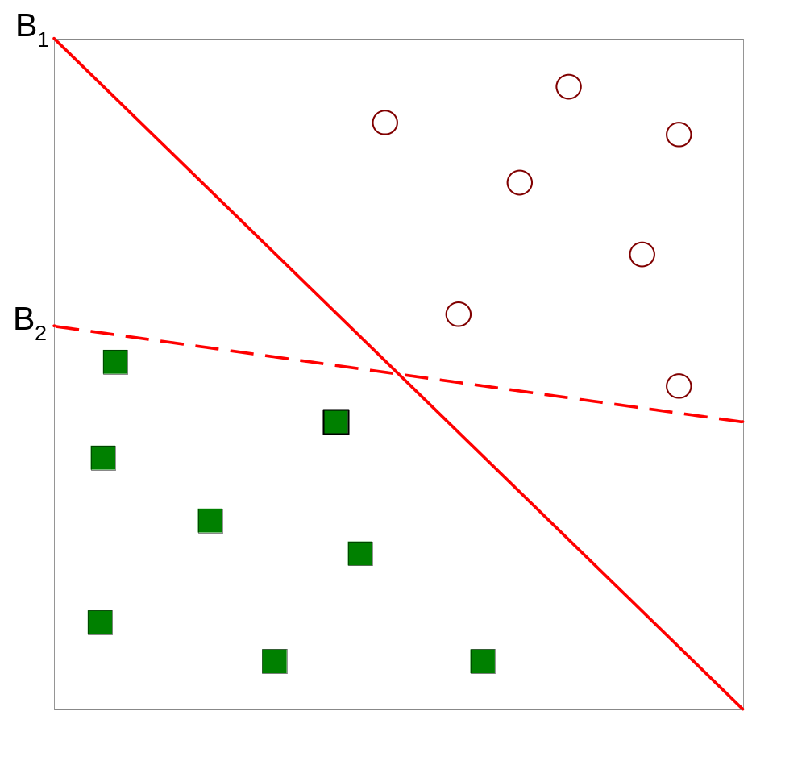
Support Vector Machines
Which one is better? B1 or B2?
How do you define better?

Slide 39
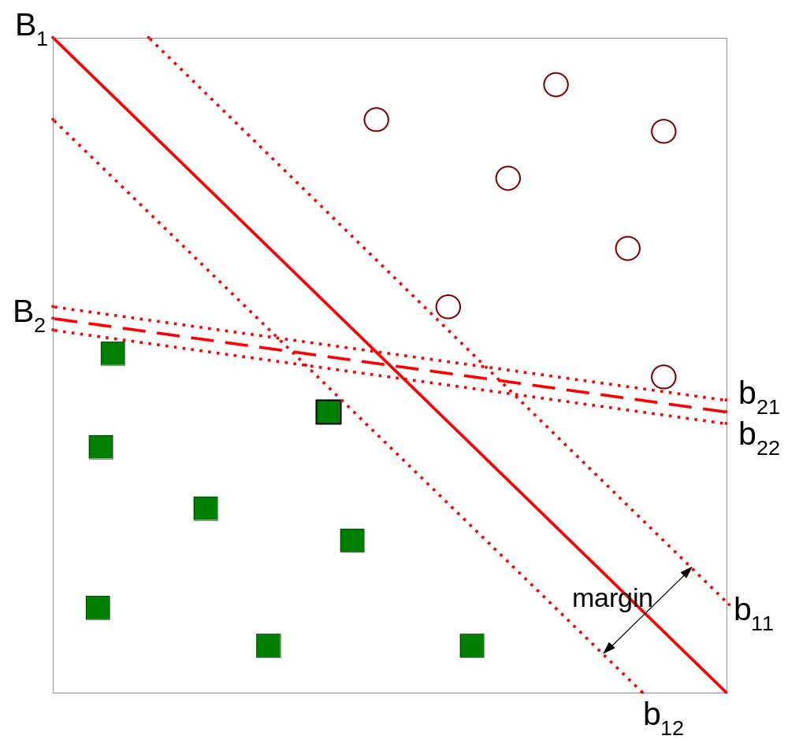
Support Vector Machines
Find hyperplane maximizes the margin => B1 is better than B2

Slide 40
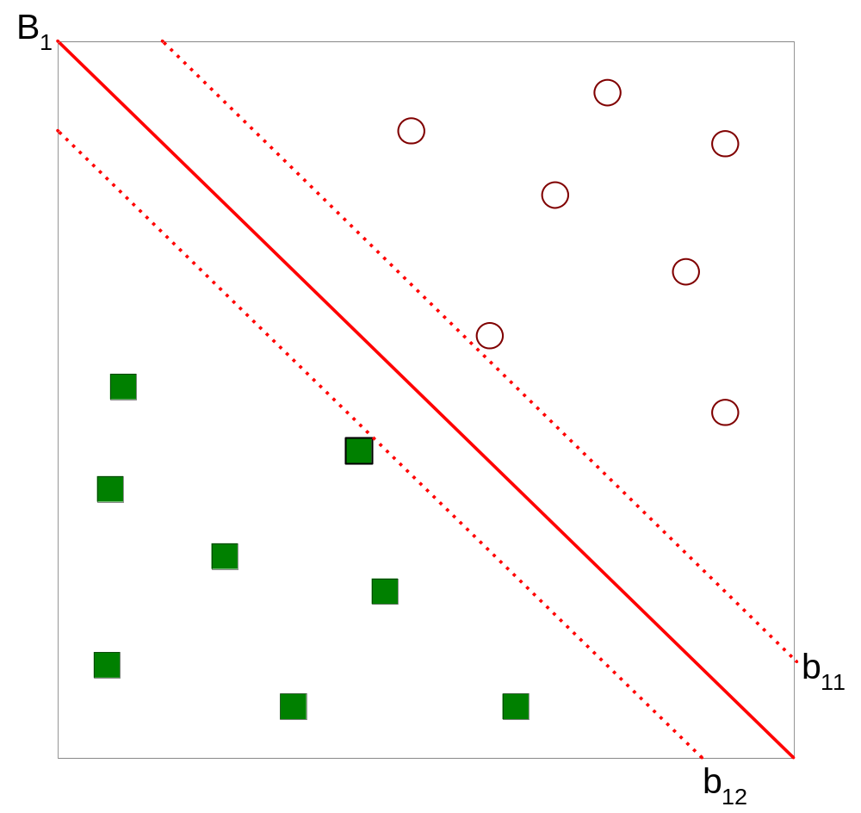



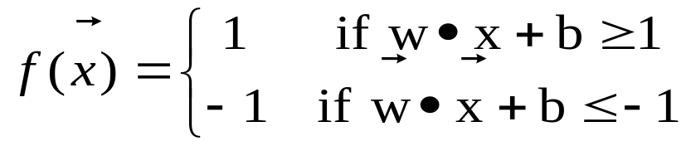
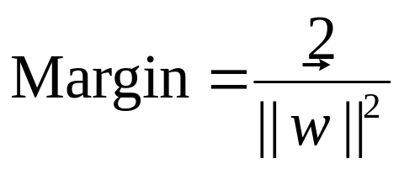
Support Vector Machines

Slide 41
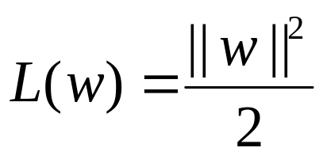
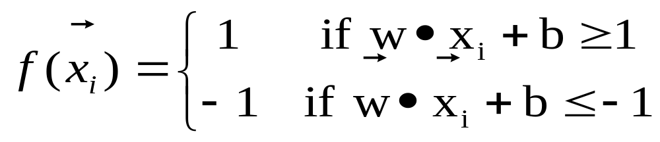
Support Vector Machines
We want to maximize:
  Which is equivalent to minimizing:
  But subject to the following constraints:
    This is a constrained optimization problem
      Numerical approaches to solve it (e.g., quadratic programming)

Slide 42
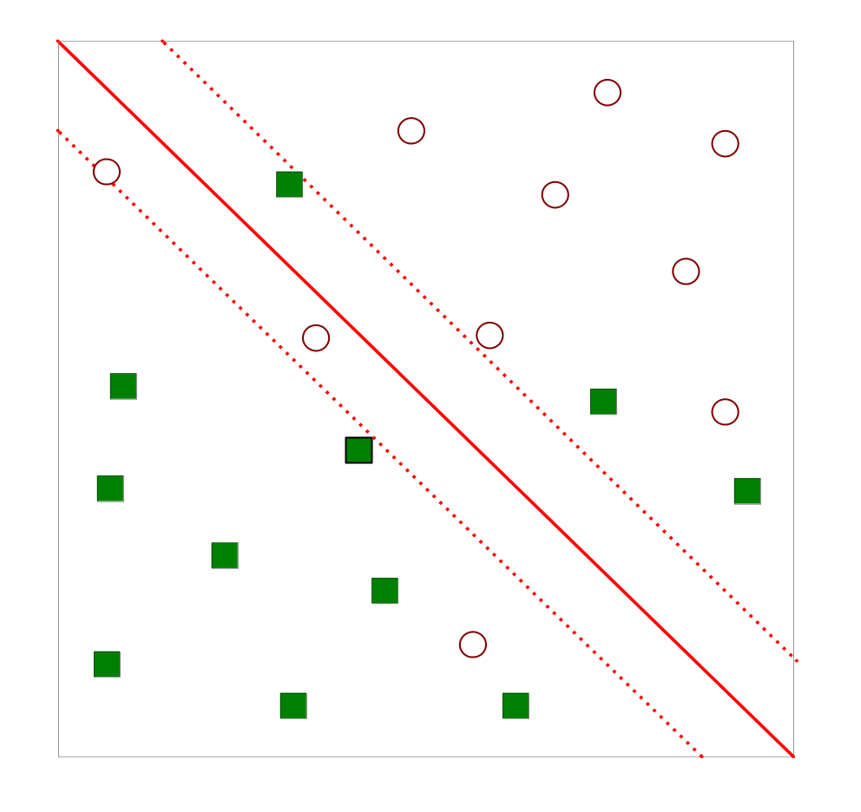
Support Vector Machines
What if the problem is not linearly separable?

Slide 43

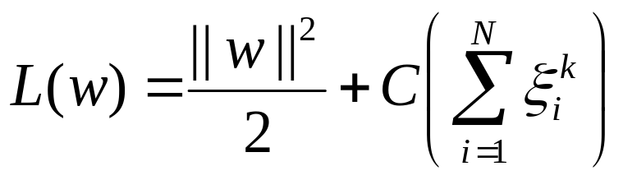
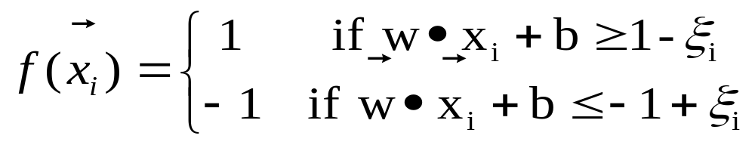
Support Vector Machines
Introduce slack variables
  Need to minimize:
  Subject to:

Slide 44
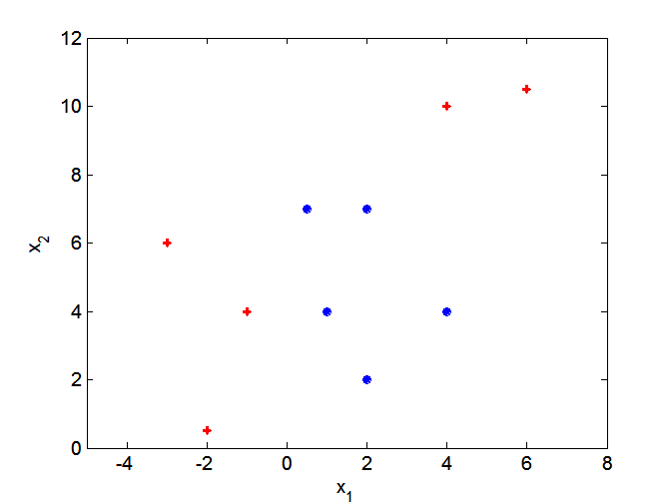
Nonlinear Support Vector Machines
What if decision boundary is not linear?

Slide 45
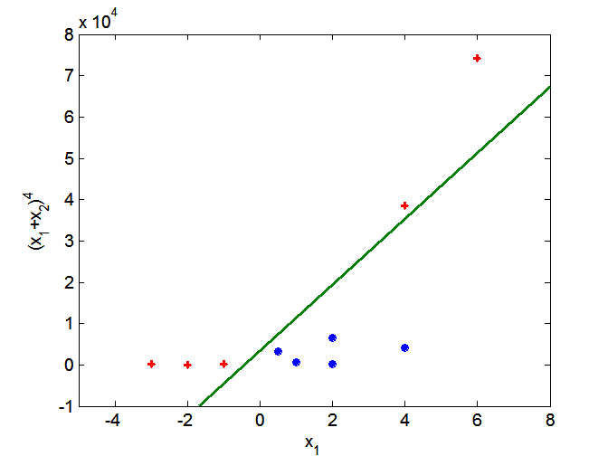
Nonlinear Support Vector Machines
Transform data into higher dimensional space

Slide 46
Ensemble Methods
Construct a set of classifiers from the training data set
Predict class label of previously unseen records by aggregating predictions made by multiple classifiers

Slide 47
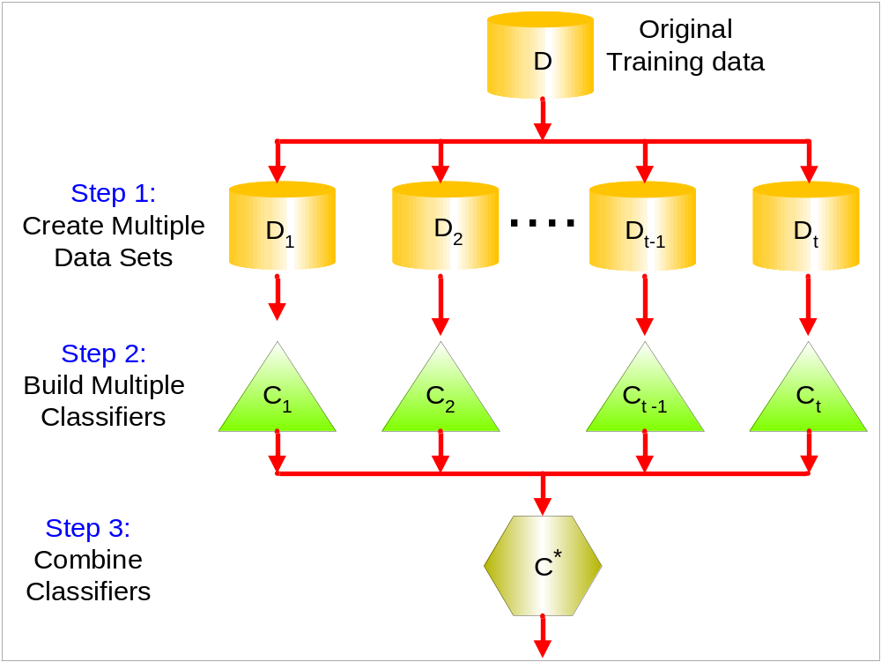
General Idea

Slide 48
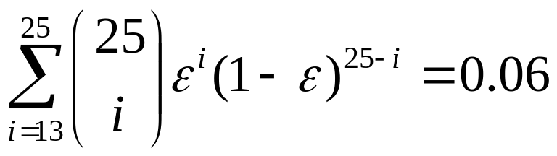
Why does it work?
Suppose there are 25 base classifiers
  Each classifier has error rate, ε = 0.35
  Assume classifiers are independent
  Probability that the ensemble classifier makes a wrong prediction:

Slide 49
Examples of Ensemble Methods
How to generate an ensemble of classifiers?
  Bagging
  Boosting

Slide 50
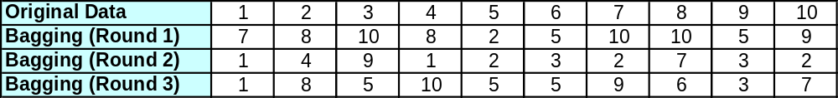
Bagging
Sampling with replacement
Build classifier on each bootstrap sample set
Each sample data point has probability 1 – (1 – 1/n)^{n} of being selected

Slide 51
Boosting
An iterative procedure to adaptively change distribution of training data by focusing more on previously misclassified records
  Initially, all N records are assigned equal weights
  Unlike bagging, weights may change at the end of boosting round

Slide 52
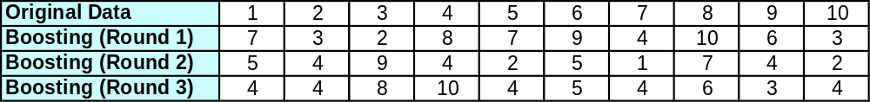
Boosting
Records that are wrongly classified will have their weights increased
Records that are classified correctly will have their weights decreased
Example 4 is hard to classify
Its weight is increased, therefore it is more likely to be chosen again in subsequent rounds

Slide 53
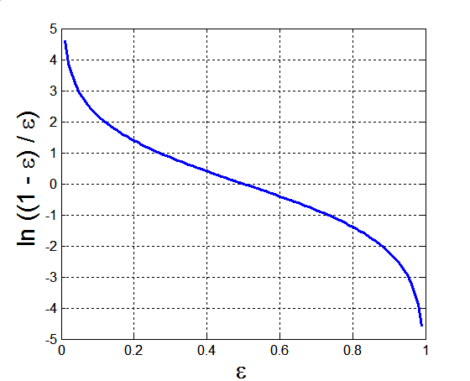
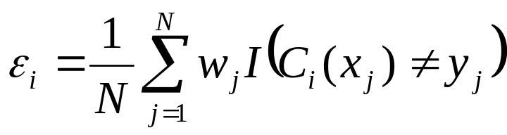
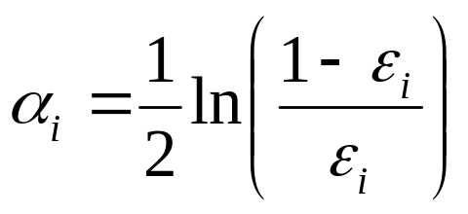
Example: AdaBoost
Base classifiers: C₁, C₂, …, C_{T}
Error rate of C_{i}:
I(p)=1 if the predicate p is true;
0 otherwise
Importance of a classifier:

Slide 54
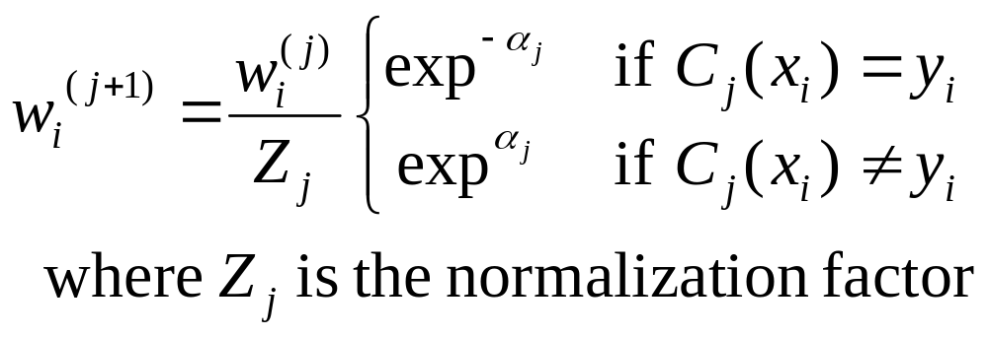
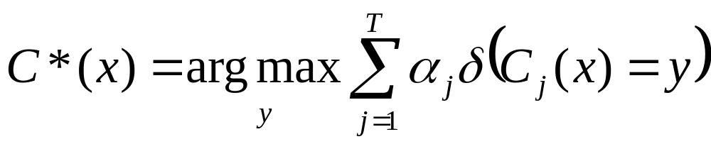
Example: AdaBoost
Weight update:
If any intermediate rounds produce error rate higher than 50%, the weights are reverted back to 1/n and the resampling procedure is repeated
Classification:

